Slide 1
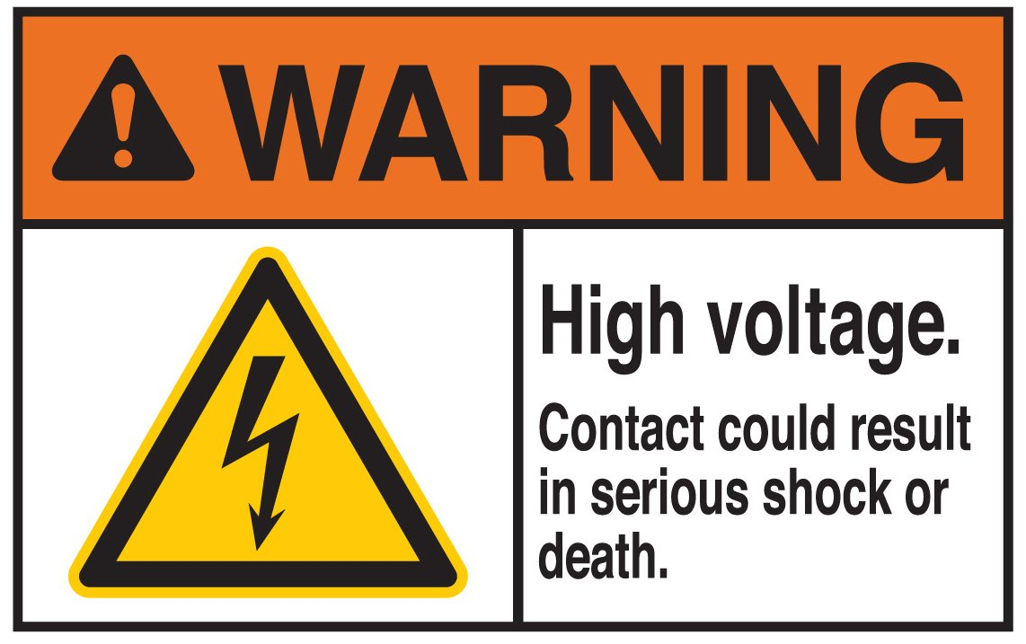
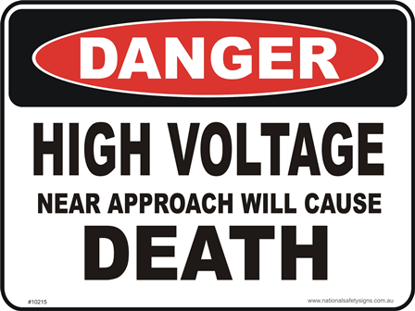

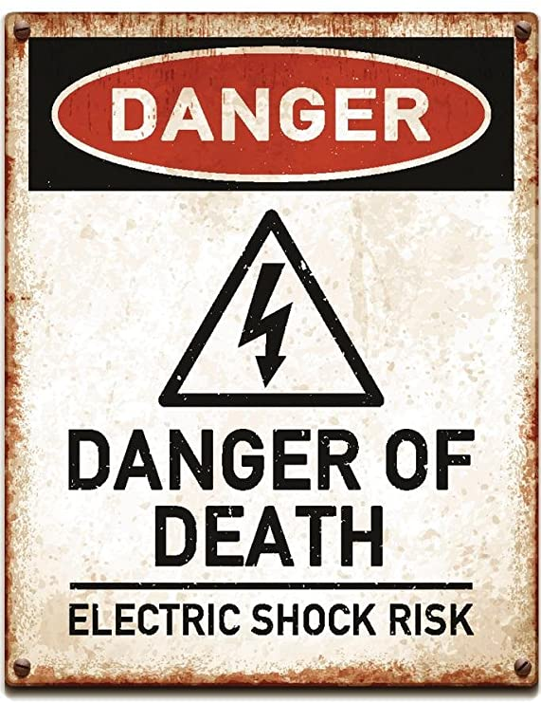
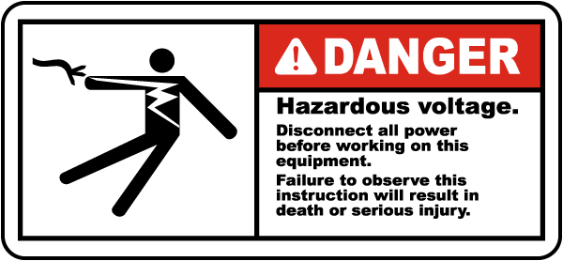
WARNING
You are taking your life, property, and everything you care about in your own hands dealing with FATIAL LEVEL VOLTAGES.
If you have any doubt or you have no experience DO NOT WIRE THE POWER SUPPLY YOURSLEF- Get a Professional to do so.
We are not responsible for you following these instructions, you do this of your own free will and action.

Slide 2
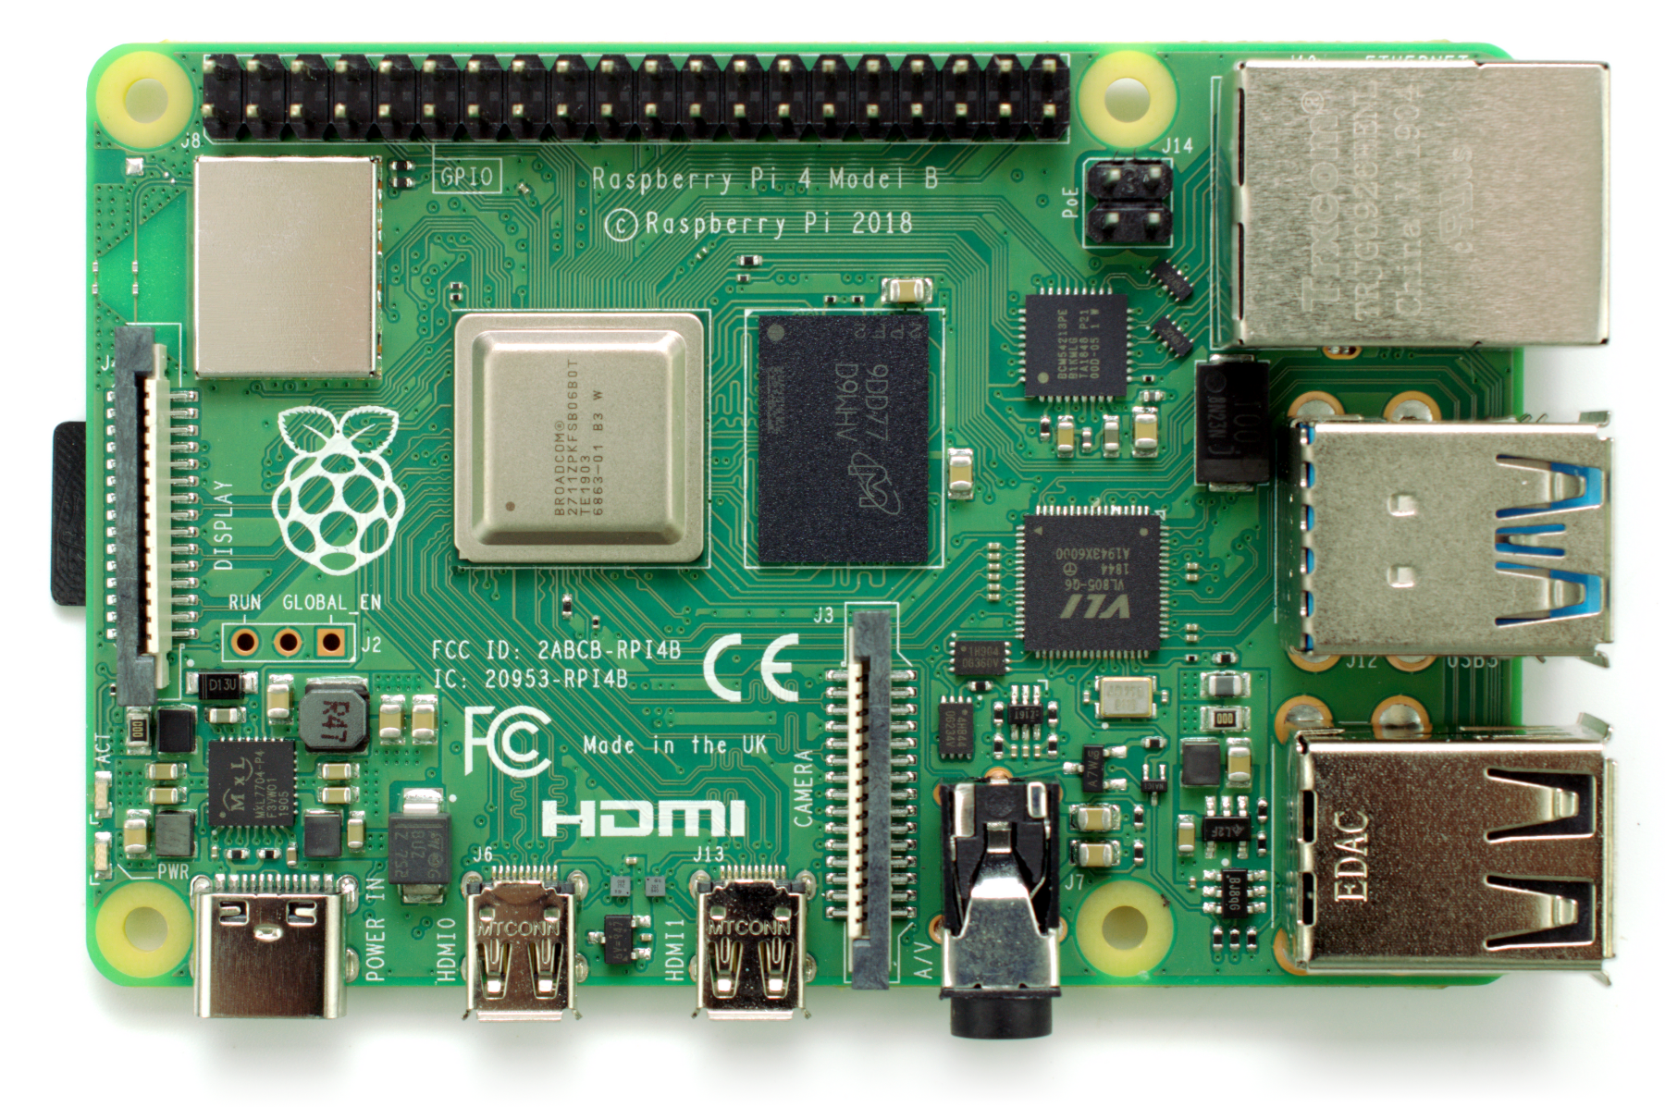
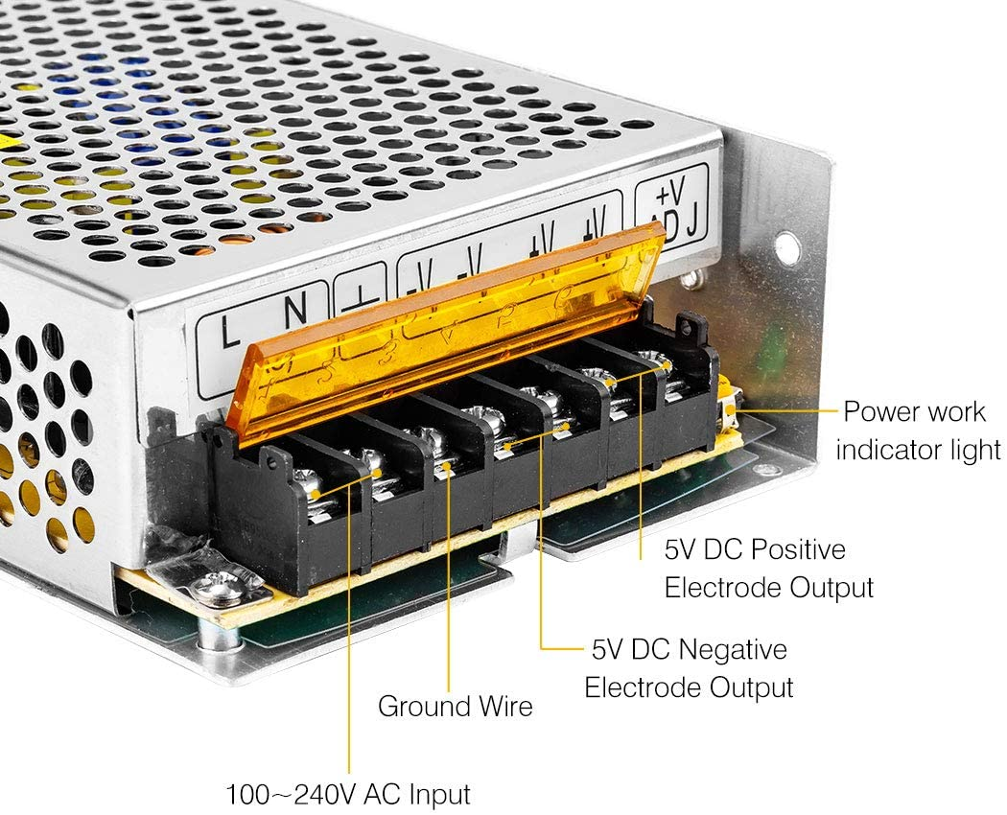
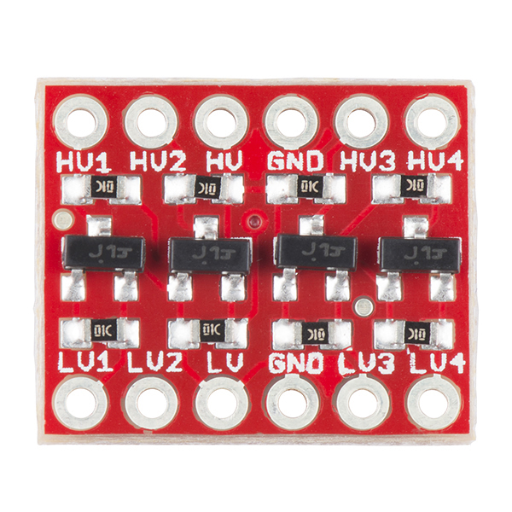
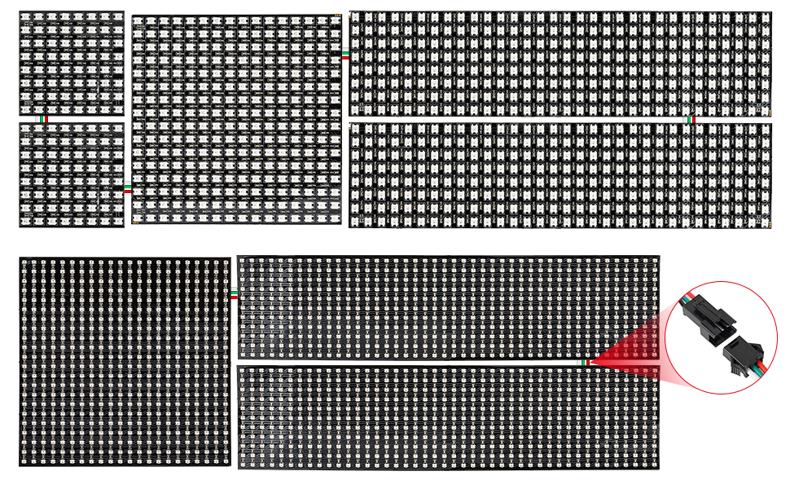
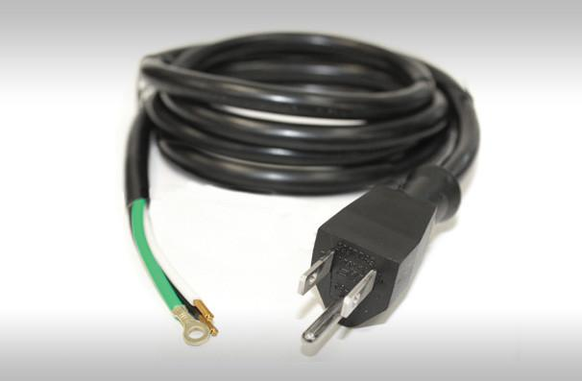
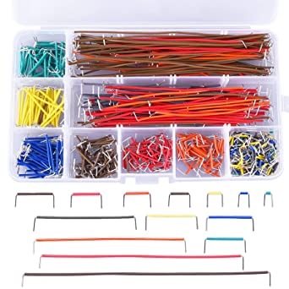
For this you will need:
Raspberry PI 3b or greater
Raspberry Pi OS
Updated (sudo get-apt update && get-apt upgrade)
Loaded with Python 3.
Loaded with proper libraries to support WS2812b LED Matrix and other
Python Liabrarys: use PIP to get libraries.
GPIO, time, rpi_ws281x, random, Argparse
1x 120VAC to 5VDC Transformer: Suggested Vendor BTF Lighting
1x 3.3V to 5V logic level converter: Suggested Vendor KeeYees
1x 16x16 WS2812b LED Matrix: Suggested Vendor BTF Lighting
1x Pigtail or old extension cord (you will be cutting an end off unless you already have a spare 120V cable with plug.
7x Black or Green Wires
6x Red Wires
2x Blue Wires

Slide 3
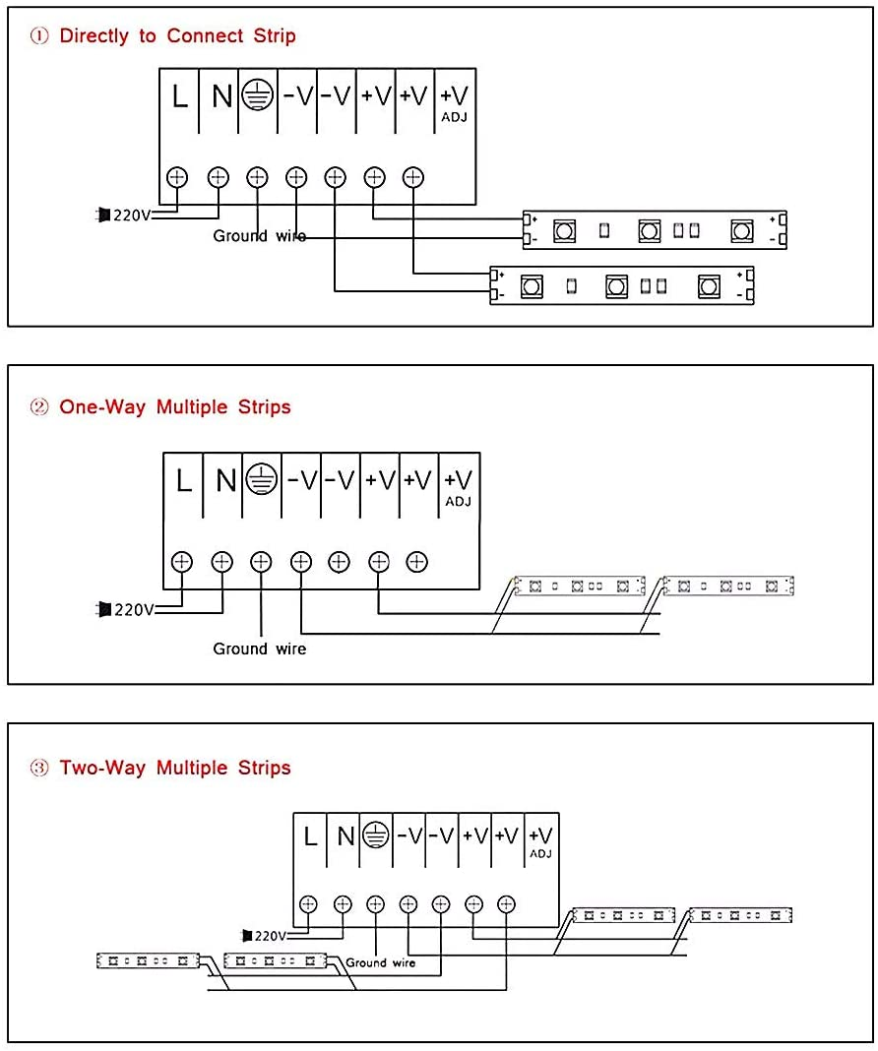
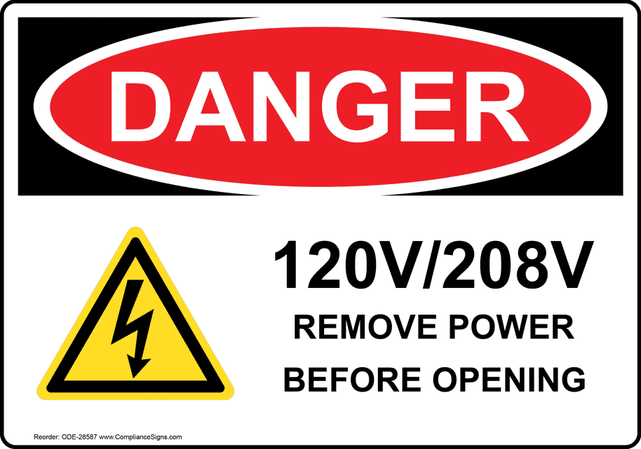
LED POWER SUPPLY:
120VAC/220VAC 60Hz 2.5A =300W (120*2.5): W=A*V (or I*V)
Output: 5VDC Max 60A =300W (5*60): W=A*V (or I*V)
Have a multimeter handy.
After looking and reading RED warnings:
You do this at your own risk
Connect plug wire to 100-240 AC Input-
Verify Polorized Plug connection is right.
Put down plastic safety cover.
Plug in.
Use Multimeter to adjust 5VDC power output to
EXACTLY 5VDC
AMAZON BTF LIGHTING 120VAC to 5VDC TRANSFORMER
IMPORTANT SAFETY TIP!!!!
120VAC will sting, burn, injure and
KILL.
IT IS OUT TO GET YOU.
DO NOT: Hug it. Lick it. Put a fork in in. Put a screw driver across it.
DO NOT: Expose the wires-
look left- PUT DOWN THE PLASTIC (non conducting) SAFTY SHIELD
After you have connected the line for that voltage.
Don’t have it plugged in even if you are just working on the DC side- Bad things can happen!
LIKE DEATH

Slide 4
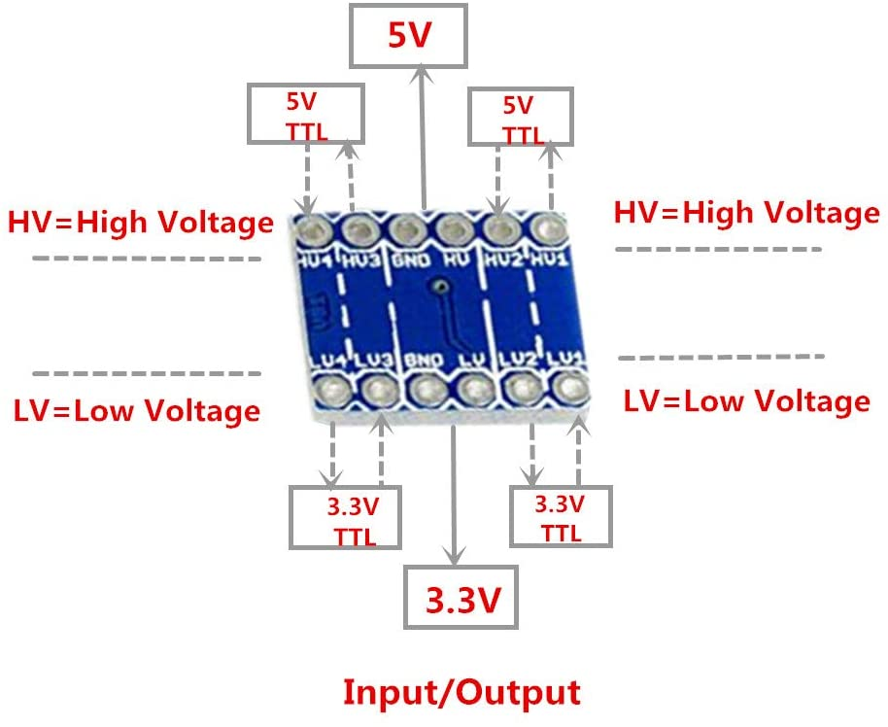
You must connect the HV(High Volt) and GND to a 5VDC source
-Can be shared GND (Ground)
You must connect the LV(Low Volt) and GND to a 3.3VDC source
-Can be shared GND (Ground)
Amazon 3.3V to 5V Logic Level Converter

Slide 5
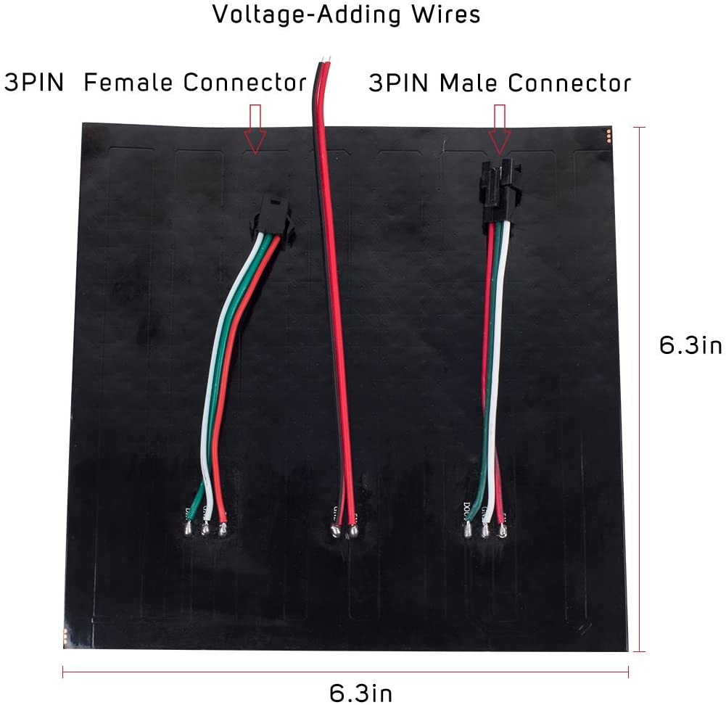
BTF LIGHTING WS2812b BTF Lighting Matrix 16x16.
GRB(Green Red Blue) pattern not RGB (Red Green Blue)
Recommended power supply：DC5V10A(50w) or DC5V20A (100W)
Important advice: Always double down on the power connection.
Connect to 3Pin Male and connect to the VOLTAGE-ADDING WIRES.
This WILL avoid dimming of lights near end of strip.
Follow this also in all designs where you connect more than 1 matrix or strip.
AMAZON BTF LIGHTING WS2812b BTF Lighting Matrix 16x16

Slide 6
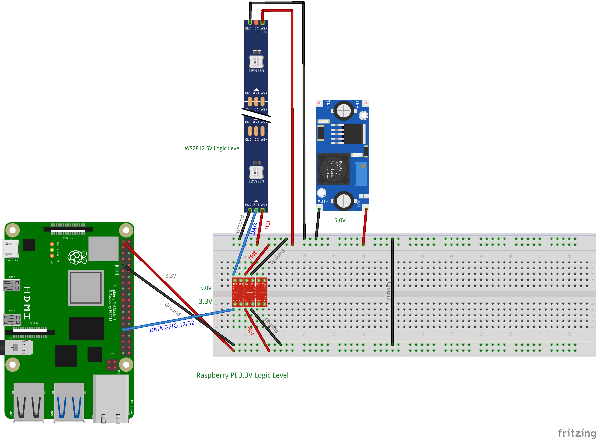
The Data/DTC noted here is from a WS2812 Strip- not a matrix but the same setup applys.
(There is not a 16x16 Matrix WS2812b on fritz)

